Slide 1
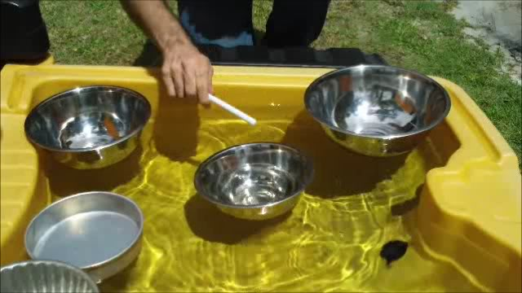
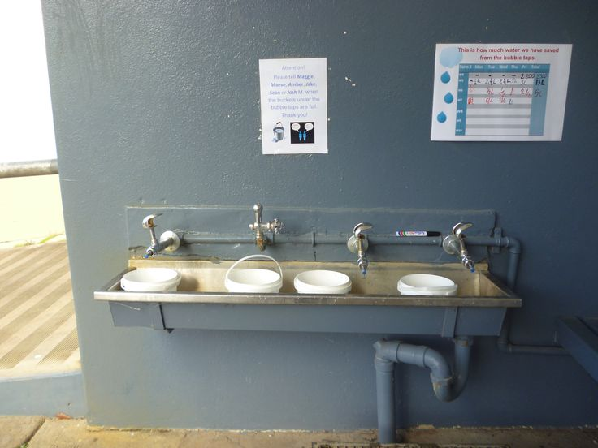
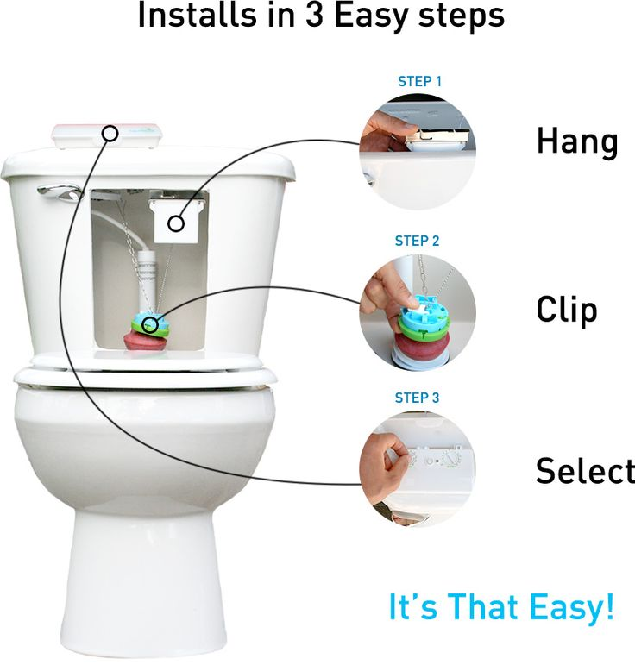
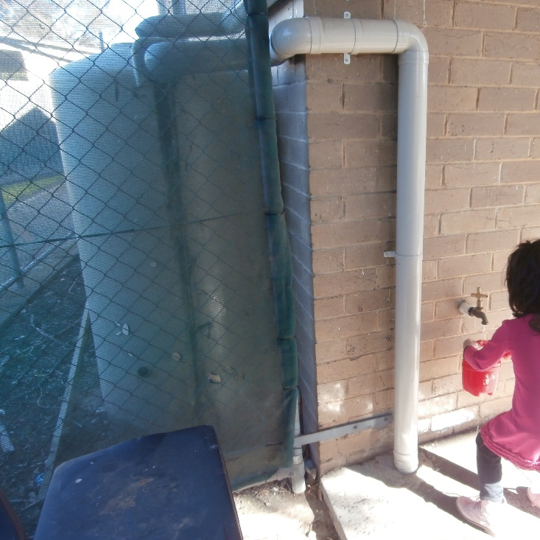
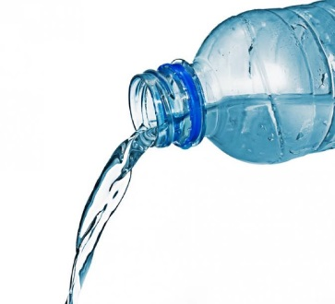
Water Saving Techniques in Early Childhood
Buckets under the bubble taps or hand washing basin saves wasted water to tip onto our plants, trees and grass area.
Use leftover water from water play to tip onto plants, grass, trees, bird baths or pot plants.
Tip leftover water from drink bottles into a bird bath or directly onto plants
Talk to management about altering toilets to a dual flush water saver device
Install a water tank for children to access to water garden areas and to use for water play.

Slide 2
Do your part – don’t wait for someone else to act. Work as a team to improve sustainable practices at your service.
My passion for assisting educators to understand sustainability is supported by the concept of working together for success and is further supported by O'Sullivan (2009) who claims successful leaders do three things: behave in a particular way, have an ability to understand the needs of people and circumstances, and apply certain leadership styles at the right time. Furthermore, good leaders have acute self-awareness and understand ideals that many people associate with the role of the leader.

